Slide 1
Minimum Mode

Slide 2
MN/ MX = 1 ;minimum mode
Control signals are given out by processor
Single microprocessor
Components - latches, transreceivers, clock generator, memory and IO devices
Chip selection logic is needed for selecting memory or IO devices
Transreceivers are bidirectional buffers - data amplifiers
Transreceivers are used to separate the time multiplexed address/ data signals
DEN, DT/ R
DEN - valid data is available on the data bus
DT/R - indicates the direction of data from/to the processor

Slide 3
A system contains memory, IO devices, and clock generator
20 address lines
16 data lines
3 octal address latches to separate the address and data
2 octal data buffers
Timing diagram for read and write cycle

Slide 4
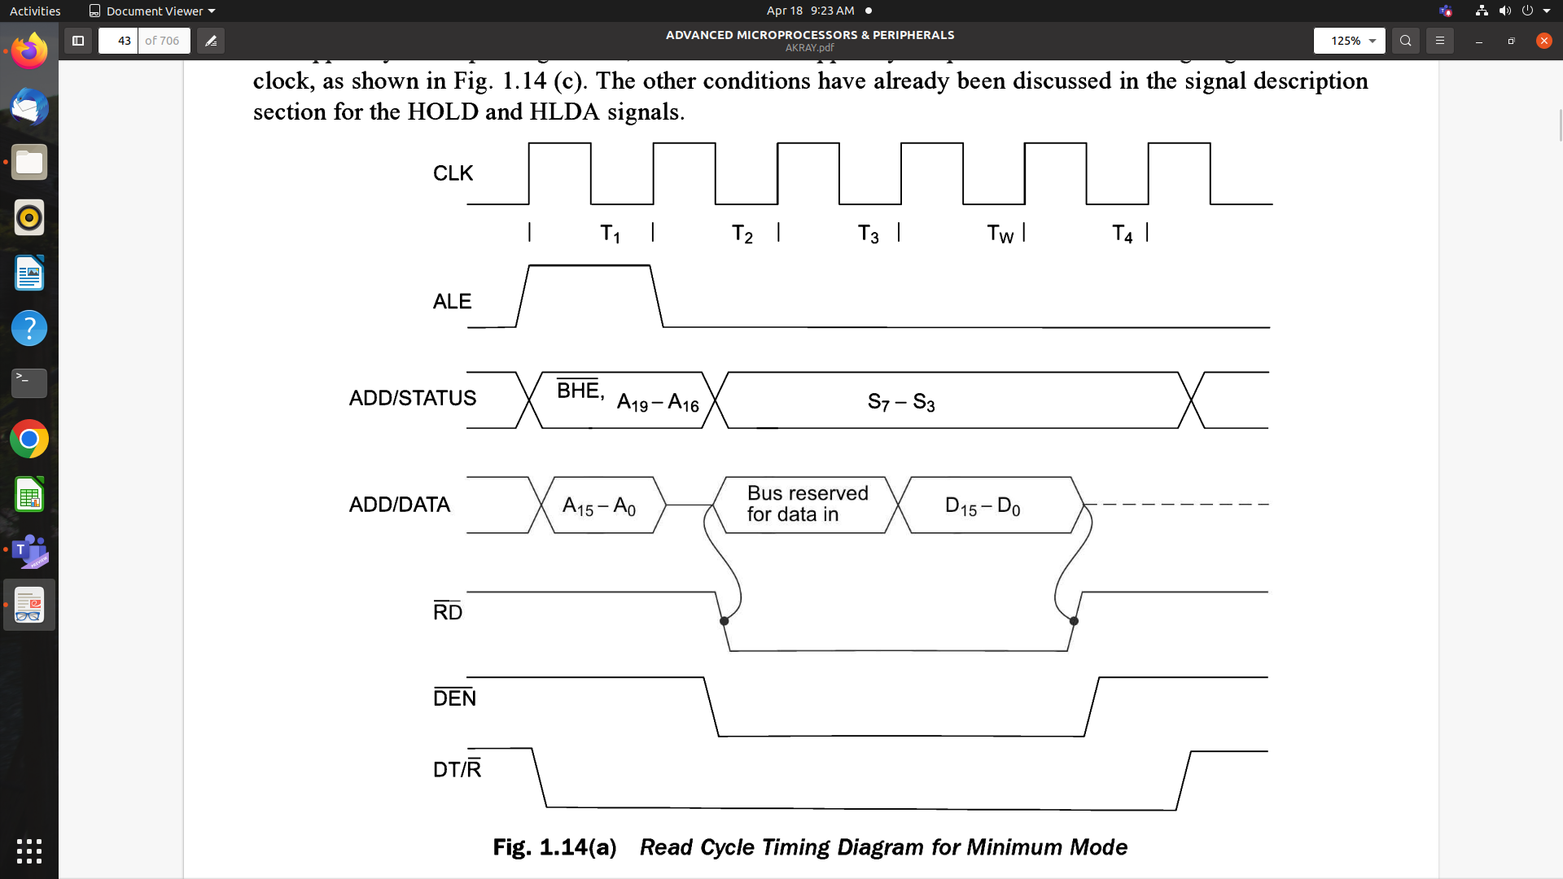

Slide 5
Read cycle begins in T1 - ALE and M/IO
Valid address is latched on the local bus
BHE and A0 signals address low, high, or both bytes
From T1 to T4, M/IO indicates Memory or IO operation
At T2 address is removed
At T2, RD control signal is activated
Addressed device enable its data bus drivers
RD goes low and data is available on the data bus
Addressed device will drive the READY pin high

Slide 6
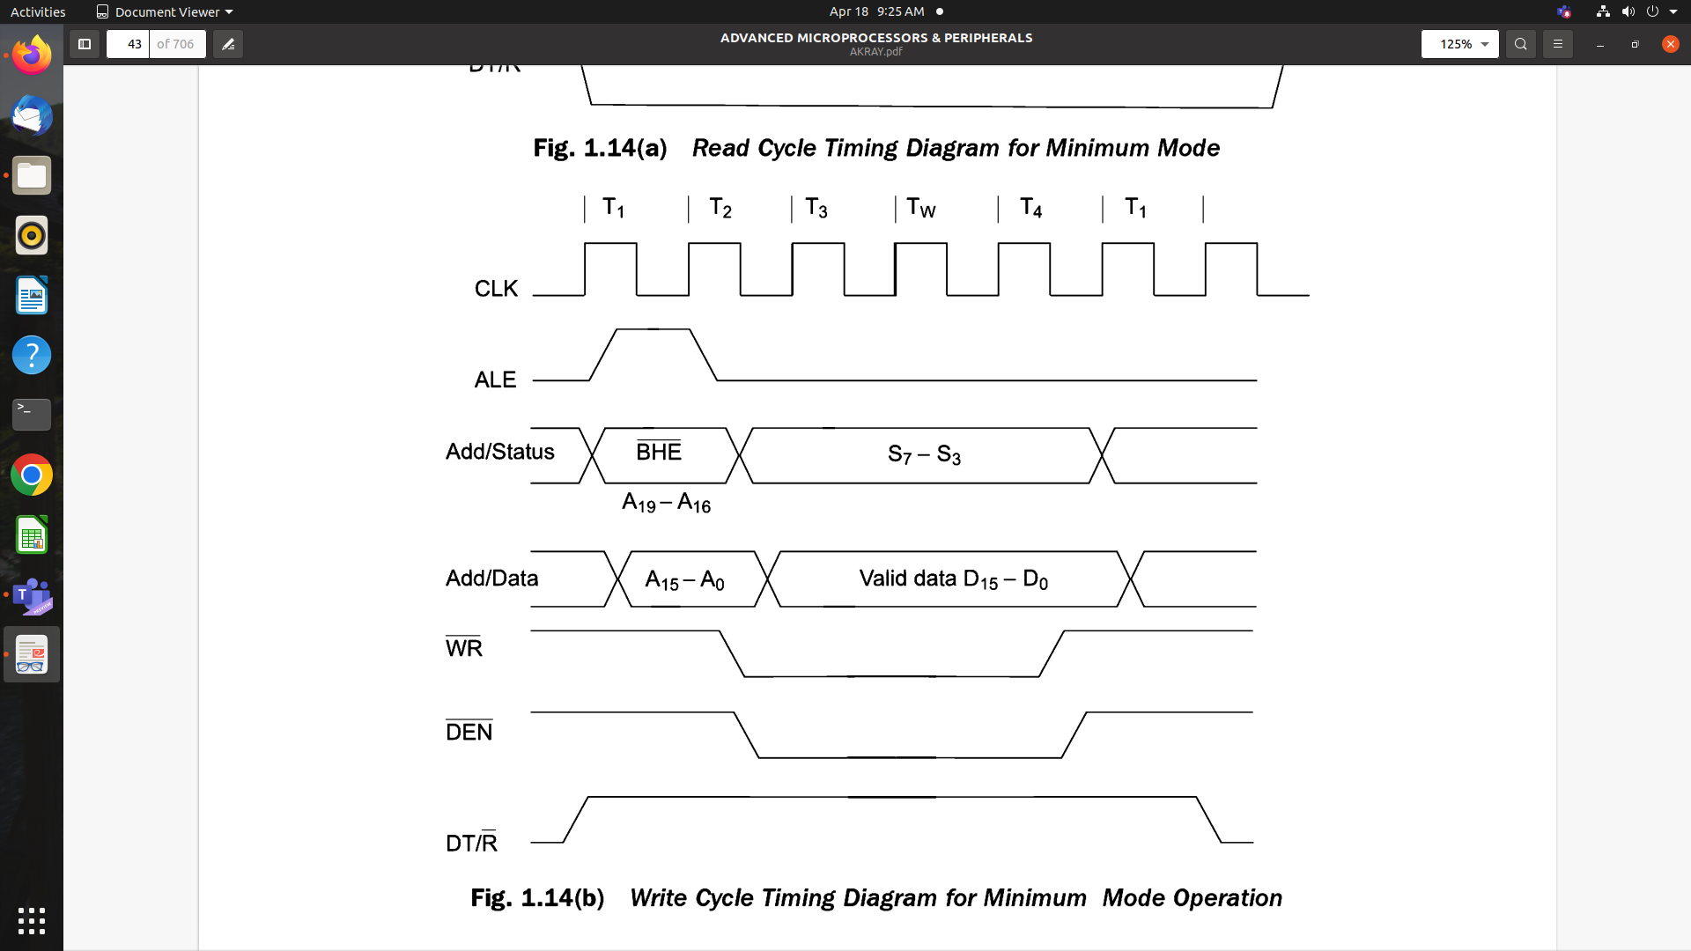

Slide 7
Write cycle - assertion of ALE and address is available in T1
M/IO signal is again asserted to indicate Memory or IO operation
In T2, the processor sends the data to be written to the addressed location
T2, WR becomes active
Data remains on the bus until the middle of T4
BHE and A0 signals are used to select the proper byte(s) of memory or IO word to be read or written

Slide 8
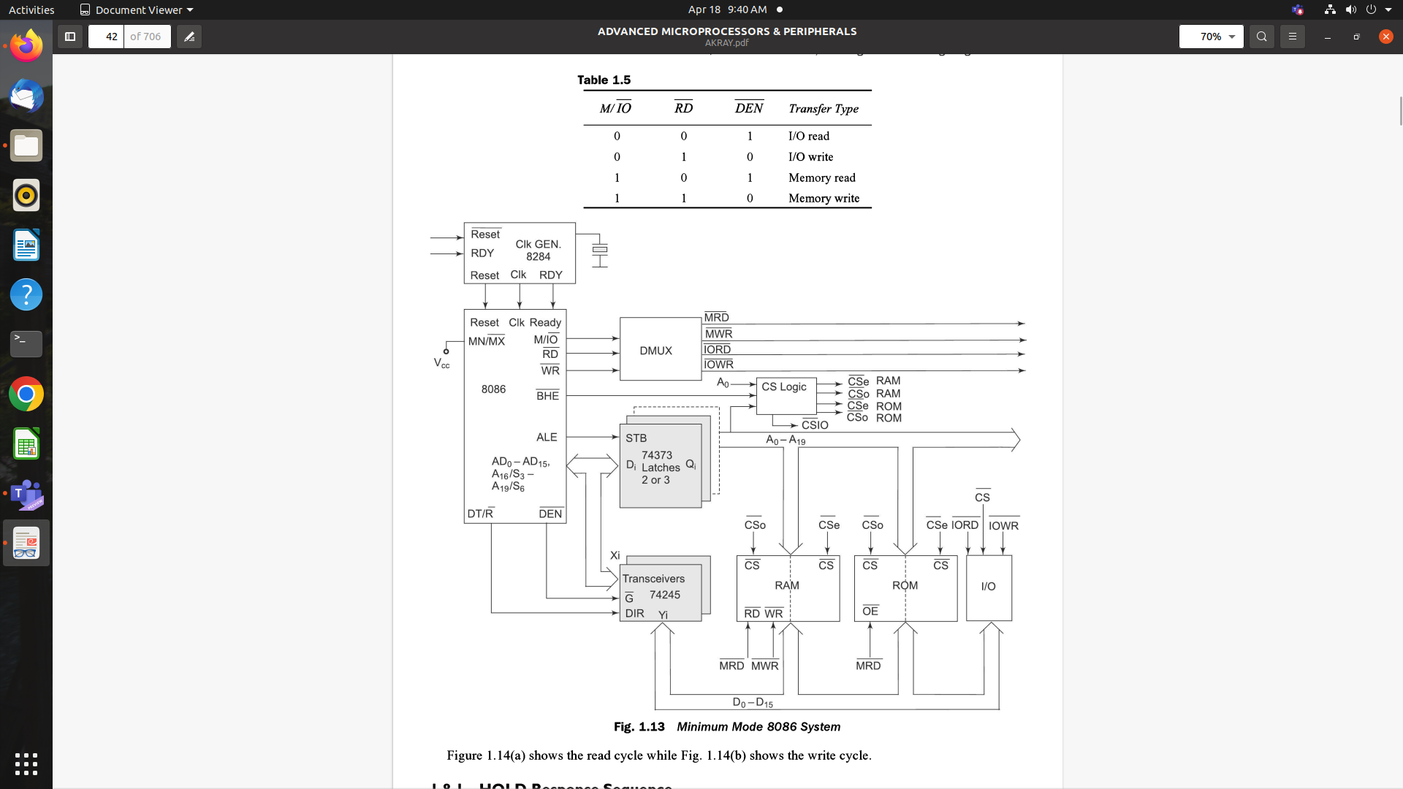

Slide 9
HOLD response sequence
HOLD pin is checked at the end of each bus cycle
If it is received active by the processor before T4 of previous cycle or during T1 state of the current cycle, the CPU activates HLDA in the next clock cycle and for the succeeding bus cycles, the bus will be given to another requesting master.
The control of the bus is not regained by the processor until the requesting master does not drop the HOLD pin low.
When the request is dropped by the requesting master, the HLDA is dropped by the processor at the trailing edge of the next clock.

